Slide 1
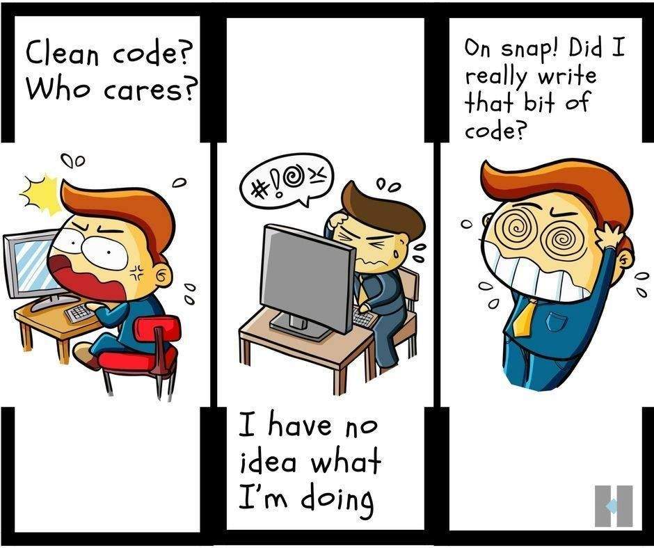
Housekeeping

Slide 2
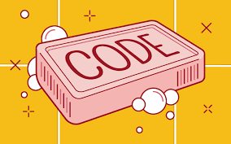
Structuring your code
Why structuring your code?
Organization
Code quality
Allows for easy collaboration
Makes your project reproducible!
What did I do ???
Ultimately ...
other people will thank you ....
YOU WILL THANK YOU!!

Slide 3
Structuring your code
Getting started
You first need to install the requirements!
Python 3.x
cookiecutter Python package
pip install cookiecutter
cookiecutter is a command-line utility that creates projects from cookiecutters (project templates).

Slide 4
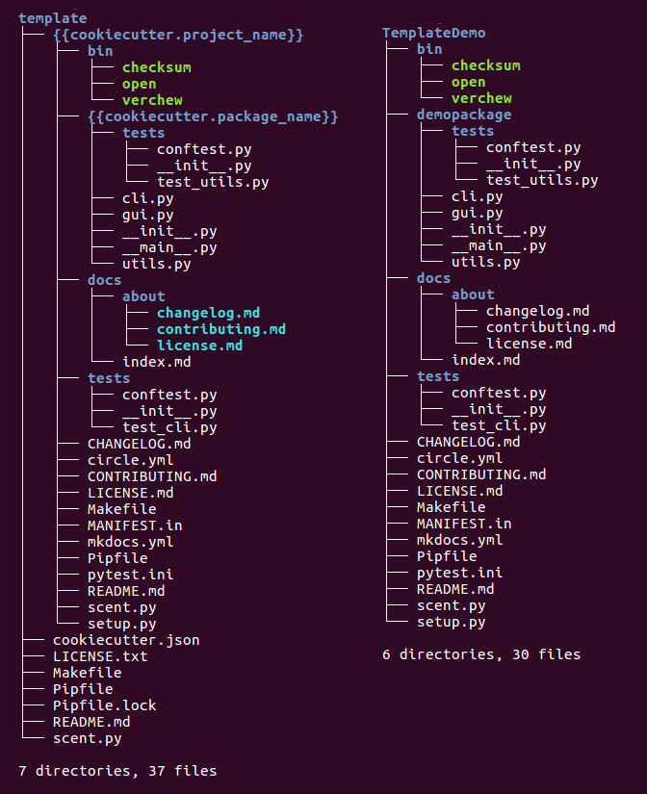
Why cookie?
save time constructing a new repository
avoid forgetting mandatory files like Readme or Changelog
lower the entry level to new collaborators — new team members, freelancers, partners
Also use to set standards

Slide 5
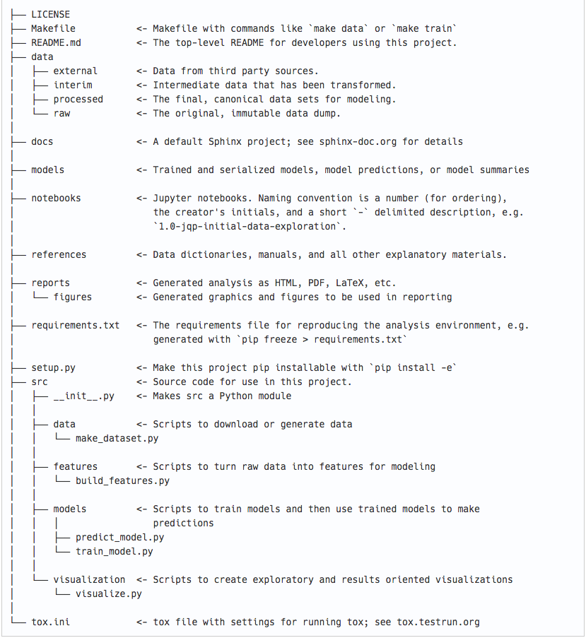
other examples
├─src
│ └─ packagename
│ ├─ __init__.py
│ ├─ ...
│ └─ tests
│ └─ ...
└─ setup.py

Slide 6
Good coding and project management
There are some opinions that have grown out of experience with what works and what doesn't when collaborating on different projects:
Notebooks are for exploration and communication
Analysis should be reproducible → can use Makefiles
Build from the environment up
Keep secrets and configuration out of version control
Be conservative in changing the default folder structure
And always use version control!
Use Secrets for things which are actually secret like API keys, credentials, etc
Use ConfigMaps for not-secret configuration data

Slide 7
Writing a good script
Why?
Easy to read
Easy to execute
Easy to debug
Removes unnecessary portions of the code

Slide 8
Writing a good script
Backwards compatibility with newer python versions
#! /usr/bin/env python
# -*- coding: utf-8 -*-
# AUTHOR
# Created : DATE
# Last Modified: DATE
# UNIVERSITY OR PLACE
from __future__ import absolute_import, division, print_function
__author__ = ['AUTHOR']
__copyright__ = ["Copyright 2018 AUTHOR, "]
__email__ = ['EMAIL ADDRESS']
__maintainer__ = ['AUTHOR']
"""
"""
if __name__=='__main__’:
main(args)
The code inside the if statement is not executed when the file's code is imported as a module.
*Don’t need create-mod date if using github

Slide 9
Environment
A project must always have a defined environment!
environment.yml
You can activate the environment by
# Install environment
conda env create -f environment.yml
# Activate environment
source activate <environment>

Slide 10
Git + GitHub

Slide 11
Setup
Make account using GitHub
https://github.com/
Windows
Git should be installed on your computer as part of your Bash install (described above).
macOS
For OS X 10.9 and higher, install Git for Mac by downloading and running the most recent "mavericks" installer from this list. After installing Git, there will not be anything in your /Applications folder, as Git is a command line program. For older versions of OS X (10.5-10.8) use the most recent available installer labelled "snow-leopard" available here.
https://tinyurl.com/gitinstallmac2
$ git status

Slide 12
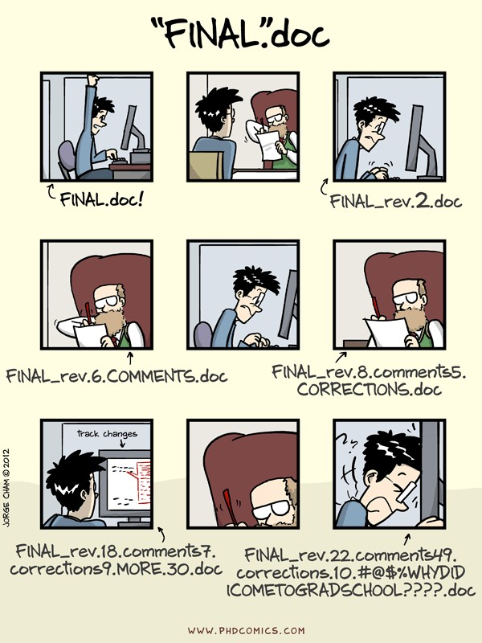
Version Control
Version control systems start with a base version of the document and then record changes you make each step of the way.
You can think of it as a recording of your progress: you can rewind to start at the base document and play back each change you made, eventually arriving at your more recent version.

Slide 13
Version Control
A version control is mostly based around one concept: Tracking changes that happen within directories or files
In most cases
Specify which files/directories to keep track of
The set of files or directories under version control are called a repository
You can either create one on Github and clone it or initialize a directory already on your computer.

Slide 14
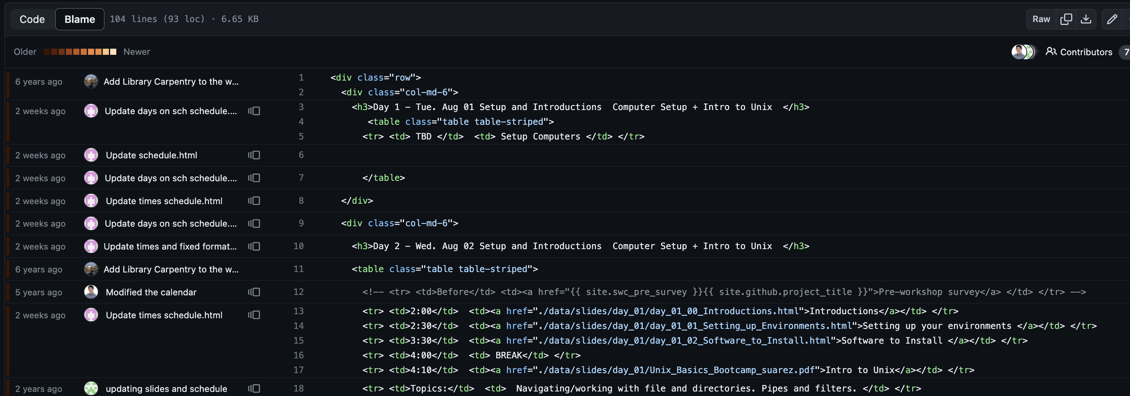
Version Control
Make backups
Keep history
View changes
Experiment
Collaborate

Slide 15
Version Control -Why?
Keep track of changes in your code
Making changes with confidence, and even reverting when needed
Relying on source control as the communication medium for your team
Easily deploying different versions of your code
Understanding who made a change and when it happened

Slide 16
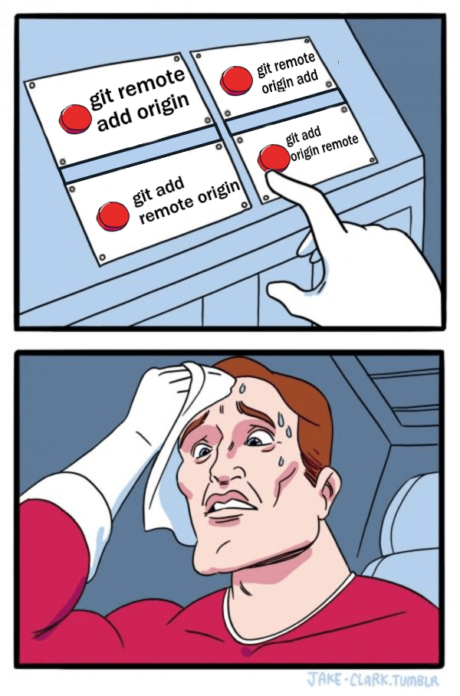
Version Control
Important vocab: working directory is different from the local repository.
The project folder is the working directory.
That's where files are created and edited.
The .git/ folder in the working directory is the local repository.
When you git add you move the file to the staging area which is the index file in .git/. Think of it like a rough draft space.
Note: If you git add and change the file before committing, you will need to git add again.

Slide 17
Version Control
As you work with your files that are under version control, each change is tracked automatically!
This can include:
Modifying a file
Deleting a file
Adding files to repository
Moving files
etc ...
When you are ready to move the file to the next version of the project, git commit moves it to .git/objects/ which is the commit history.

Slide 18
Version Control
As members of your team commit changes, it is important that you have the latest version → Reduces chance of conflict
You would do a git fetch followed by a git merge OR.
You would need to do a git pull (= git fetch + git merge) to update.

Slide 19
Version Control
If you have never added a file, you can just delete it normally.
If you did a git add atleast once then git rm filename.
If your file is being tracked and you want git to stop tracking it (but not delete it!) then do a git rm --cached filename.
Don't forget to commit these changes!

Slide 20
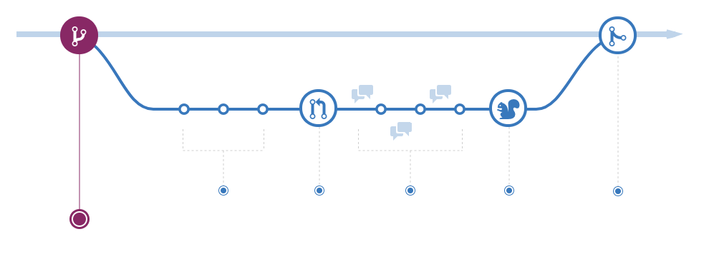
Branching
If you want to experiment with code that could break your repository, you could create a branch.

Slide 21
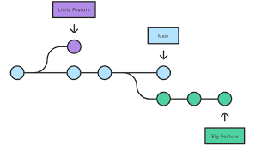
Branching
Your local working directory always represents one branch.
To see the branches that exist: git branch
To create a branch: git branch branchname
To change your working directory to the new branch: git checkout branchname

Slide 22
Branching
If you want to implement changes in a big public source code repo then you want to fork it to make sure your changes don't break the code.
The forked repository is your independent copy which you should then clone.
Once you're done making changes locally, you need to submit a pull request to merge your changes back to the source repository.
If after forking you left your repo for a while and changes have been committed to the source code you will want to make sure you have the updated version.

Slide 23
To Branch or to Fork
Both are ways to diverge from the main source code.
A branch, like a branch of a tree, remains part of the original repository. The code that is branched (main trunk) and the branch know and rely on each other and the branch knows about the code it originated from.
A fork is independent from the original repository. If the original repository is deleted, the fork remains. If you fork a repository, you get that repository and all of its branches.

Slide 24
Setting up Git, Who are you??
$ git config --global user.name "Vlad Dracula”
$ git config --global user.email "vlad@tran.sylvan.ia"

Slide 25
Creating a Repo
Repository (repo) -
A storage area where a version control system stores the full history of commits (changes) of a project and information about who changed what, when.
Main (branch) -
Branches allow you to develop features, fix bugs, or safely experiment with new ideas in a contained area of your repository.
$ cd ~/Desktop
$ mkdir planets
$ cd planets
$ git init
$ ls -a
$ git checkout -b main
$ git status

Slide 26
Tracking changes
vim mars.txt
“Cold and dry, but everything is my favorite color “
$ git status
$ git add mars.txt
tell Git to track a file using git add
$ git status
$ git commit -m "Start notes on Mars as a base"
Git now knows that it’s supposed to keep track of mars.txt, but it hasn’t
recorded these changes as a
commit yet.
$ git status
$ git log

Slide 27
Tracking changes
vim mars.txt
“The two moons are nice”
$ git status
$ git diff
$ git add mars.txt
$ git commit -m ”Adding notes on Mars’ moons"
$ git status
$ git log

Slide 28
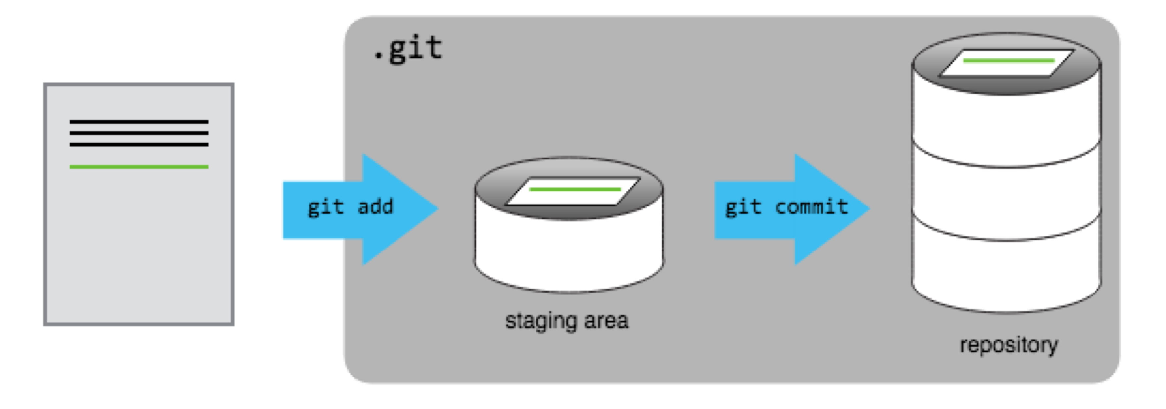
Tracking changes

Slide 29
Practice
Add some text to mars.txt noting your decision to consider Venus as a base
Create a new file venus.txt with your initial thoughts about Venus as a base for you and your friends
Add changes from both files to the staging area, and commit those changes.

Slide 30
Practice
Add some text to mars.txt noting your decision to consider Venus as a base
$ vim mars.txt
Create a new file venus.txt with your initial thoughts about Venus as a base for you and your friends
$ vim venus.txt
Add changes from both files to the staging area, and commit those changes.
$ git add mars.txt venus.txt
$ git commit -m "Write plans to start a base on Venus"

Slide 31
Directories
$ mkdir spaceships
$ git status
$ git add spaceships
$ git status
Git does not track directories on their own, only files within them.
$ touch spaceships/apollo-11 spaceships/sputnik-1
$ git status
$ git add spaceships
$ git status
$ git commit -m "Add some initial thoughts on spaceships"

Slide 32
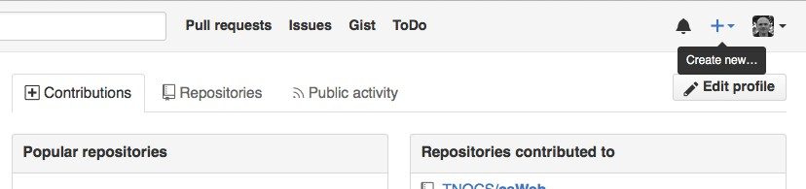
GitHub
Make a new Repo called planets
**Note: Since this repository will be connected to a local repository, it needs to be empty. Leave “Initialize this repository with a README” unchecked, and keep “None” as options for both “Add .gitignore” and “Add a license.”

Slide 33
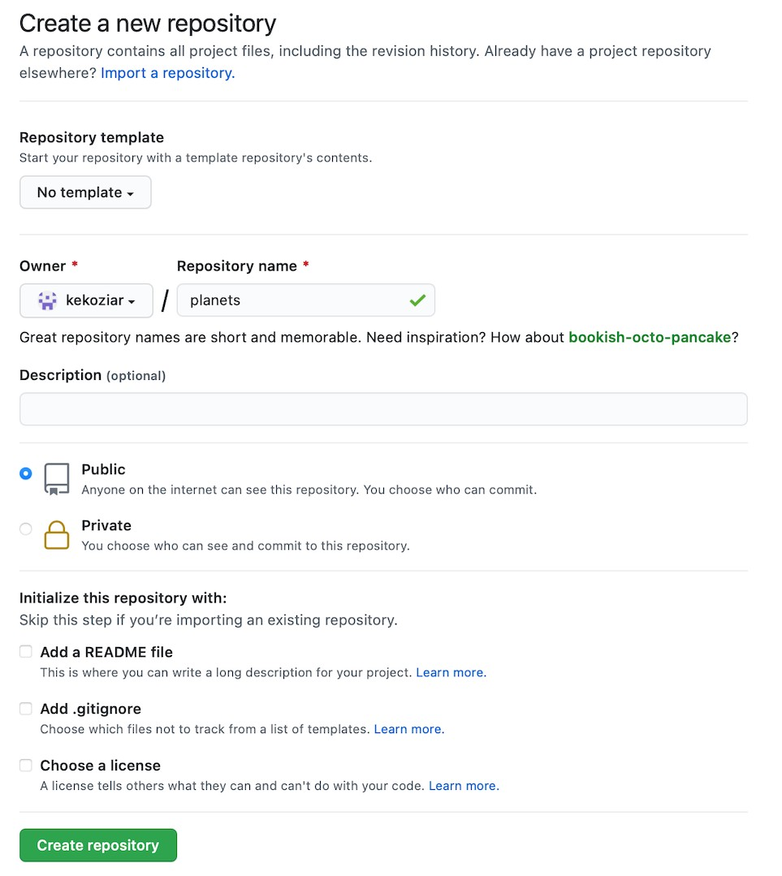
GitHub
This effectively does the following on GitHub’s servers:
$ mkdir planets
$ cd planets
$ git init
**Note that our local repository still contains our earlier work
on mars.txt, but the remote
repository on GitHub appears empty as it doesn’t contain any files yet.

Slide 34
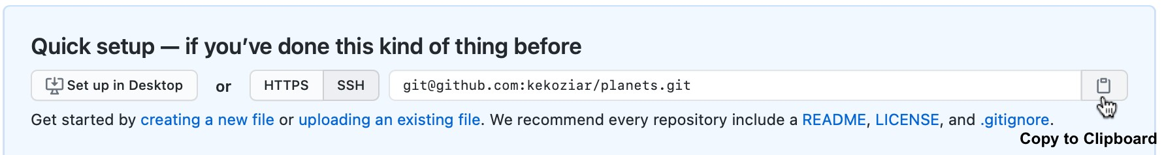
Connecting two Repos
Making the GitHub repository a remote for the local repository.
We use SSH here because, while it requires some additional configuration, it is a security protocol widely used by many applications. The steps below describe SSH at a minimum level for GitHub. A supplemental episode to this lesson discusses advanced setup and concepts of SSH and key pairs, and other material supplemental to git related SSH.

Slide 35
Connecting Repos
Copy that URL from the browser, go into the local planets repository, and run this command:
$ git remote add origin git@github.com:vlad/planets.git
origin is a local name used to refer to the remote repository
$ git remote -v

Slide 36
Connecting to GitHub
Your computer needs authenticate remote repository (GitHub)
Authenticate access using the command line.
This method is called Secure Shell Protocol (SSH). SSH is a cryptographic network protocol that allows secure communication between computers using an otherwise insecure network.
SSH uses what is called a key pair. This is two keys that work together to validate access. One key is publicly known and called the public key, and the other key called the private key is kept private

Slide 37
Connecting to GitHub
$ ssh-keygen -t ed25519 -C ”your@email.com"
Generating public/private ed25519 key pair. Enter file in which to save the key (/c/Users/Vlad Dracula/.ssh/id_ed25519):
> Enter
Enter passphrase (empty for no passphrase):
Your identification has been saved in /c/Users/Vlad Dracula/.ssh/id_ed25519 Your public key has been saved… The key's randomart image is:

Slide 38
Connecting to GitHub
ls -al ~/.ssh
Output
rwxr-xr-x 1 Vlad Dracula 197121 0 Jul 16 14:48 ./
drwxr-xr-x 1 Vlad Dracula 197121 0 Jul 16 14:48 ../
-rw-r--r-- 1 Vlad Dracula 197121 419 Jul 16 14:48 id_ed25519
-rw-r--r-- 1 Vlad Dracula 197121 106 Jul 16 14:48 id_ed25519.pub
cat ~/.ssh/id_ed25519.pub Output
ssh-ed25519
AAAAC3NzaC1lZDI1NTE5AAAAIDmRA3d51X0uu9wXek559gfn6UFNF69
yZjChyBIU2qKI vlad@tran.sylvan.ia

Slide 39
Connecting to GitHub
Go to Github.com > Settings
On settings page > “SSH and GPG keys”
Click the “New SSH key”
Paste your SSH key into the field, and click the “Add SSH key” to complete the setup.
$ ssh -T git@github.com
Hi Your Name! You've successfully authenticated, but GitHub does not provide shell access.

Slide 40

Connecting to GitHub
$ git config --global credential.helper 'cache --timeout=3600’
$ git remote add origin https://github.com/USERNAME/REPO-NAME.git
$ git branch -M main
$ git push -u origin main
Whats happening?
First push → GitHub will ask for your username and password (or personal access token if you have 2FA enabled).
Git caches it → No more prompts for the next hour.
After the timeout → You just log in again once.

Slide 41
Connecting to GitHub
touch README.md
git add README.md
git remote add origin https://github.com/user/repo.git
## get token first
https://docs.github.com/en/authentication/keeping-your-account-and-data-secure/managing-your-personal-access-tokens
git branch -M main
git push -u origin main

Slide 42
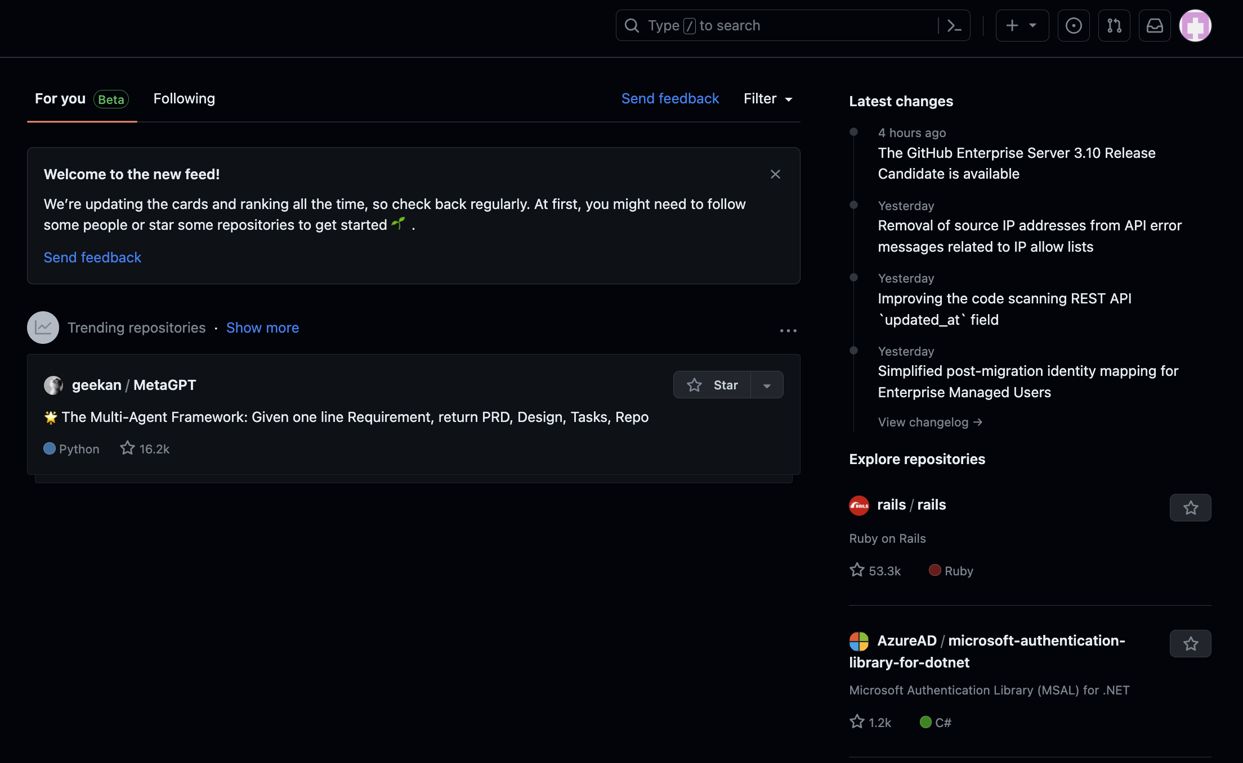
Connecting to GitHub
$ git remote add origin https://github.com/elcarrillo/[repo]
$ git branch -M main
$ git push - origin main
# username: elcarrillo
# passcode: [use the current access token] -
## do not use github password
#must go to github settings/ scroll all the way down to "developer settings" then select generate new token

Slide 43
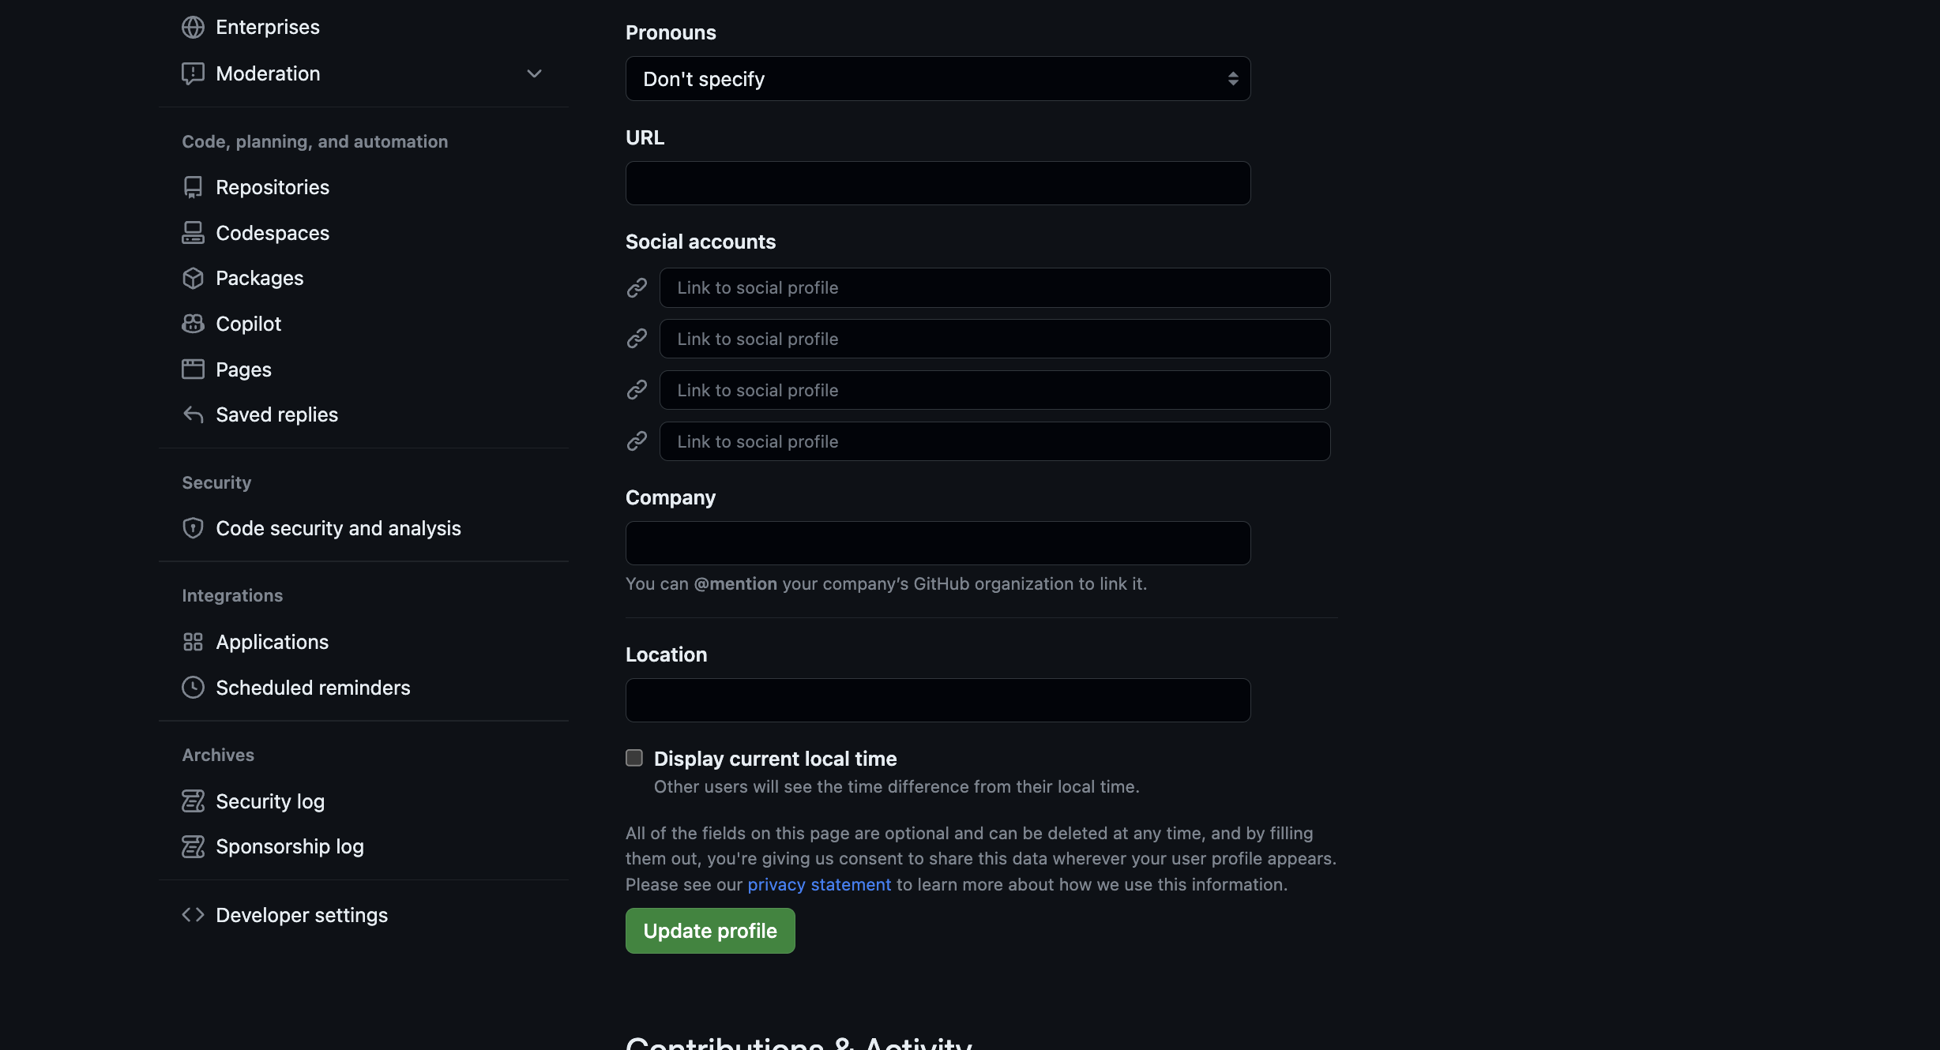
Connecting to GitHub
Developer settings>Personal accesss tokes > Tokens (classic)

Slide 44
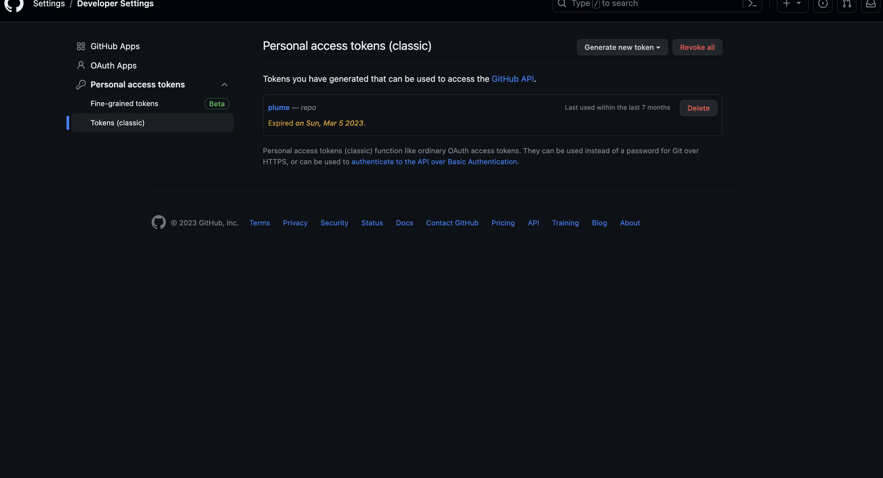
Connecting to GitHub
Click on Generate new token then select token(classic)

Slide 45
Connecting to GitHub
Now you can a note on why you need the token(ssh key)
Set the duration of this key
add scopes, check the REPO box
Scroll all the way down and click on Generate token
Now copy your new token

Slide 46
Connecting to GitHub
git branch -M main # setup your main branch
git push -u origin main # this will ask for your username
# and password, your password is # your new token!

Slide 47
Push local changes | Pull remote changes
This command will push the changes from our local repository to the repository on GitHub:
Copies changes from a local repository to a remote repository.
$ git push origin main
We can pull changes from the remote repository to the local:
Copies changes from a remote repository to a local repository
$ git pull origin main
•

Slide 48
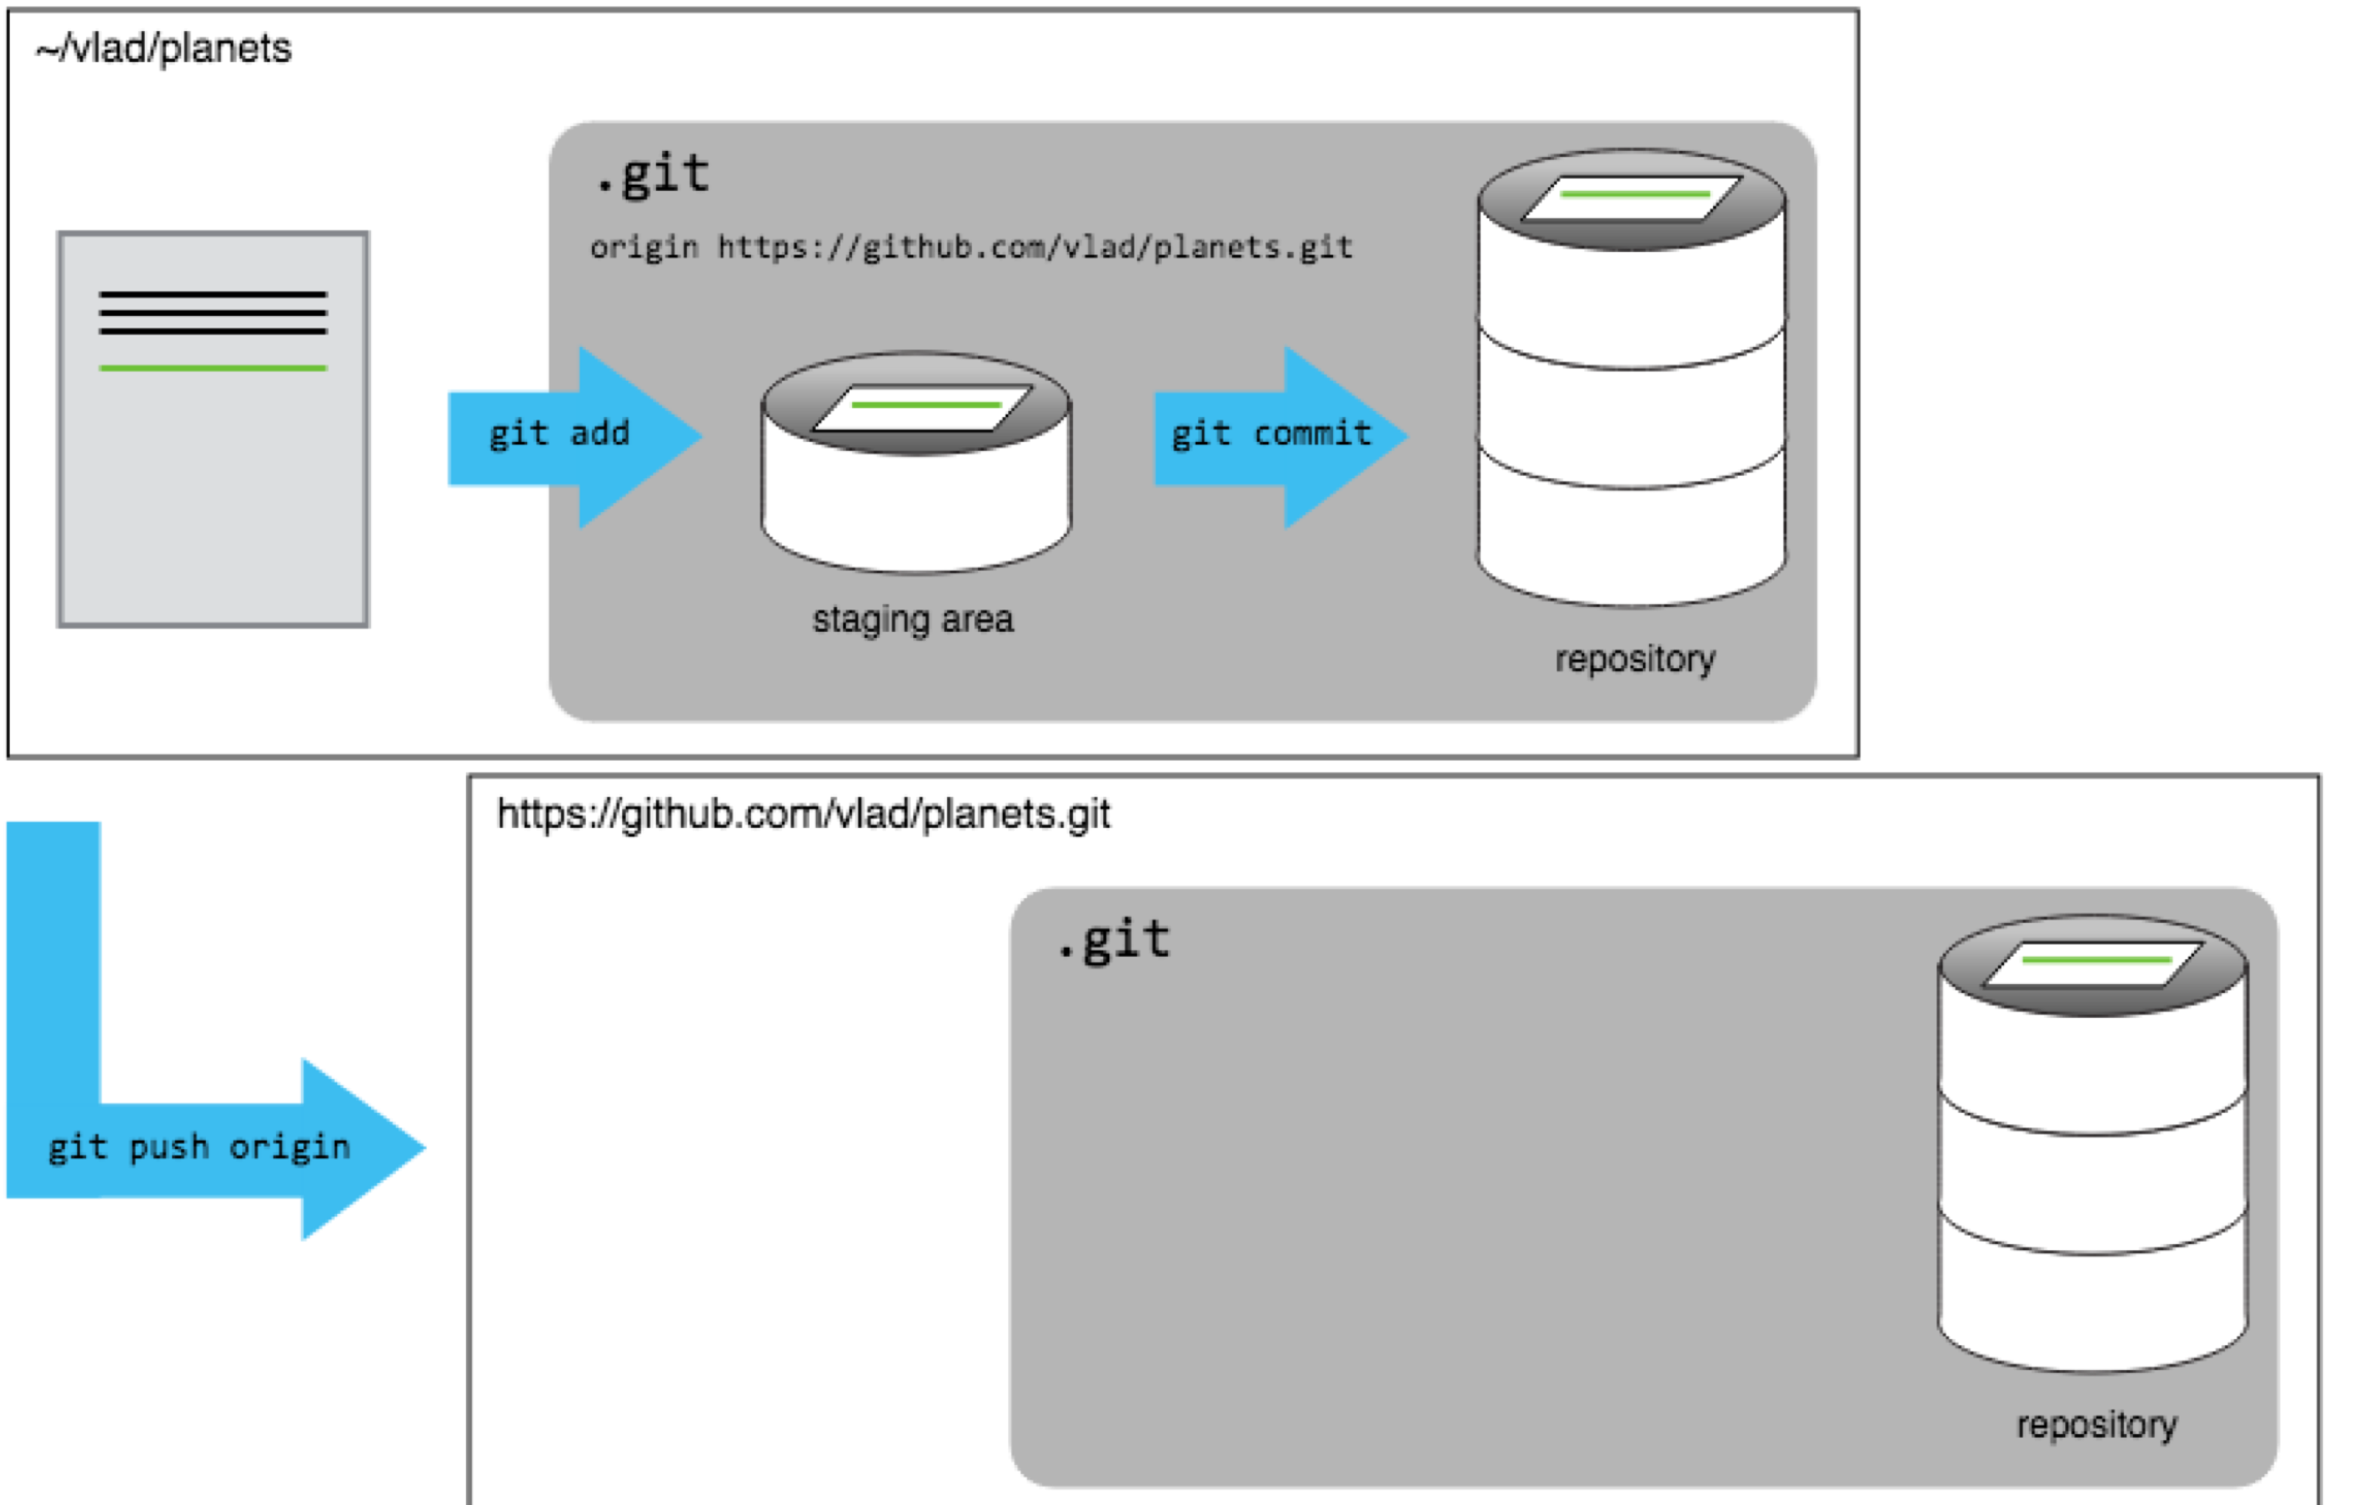
Connecting to GitHub

Slide 49
Forking
Copy of the Repo that you can work on
Contribute to code where you are not the owner or collaborator of the Repo
Practice: Fork the bootcamp repo

Slide 50
Cloning
Create a local copy on your computer and sync between the two locations
Need permission of the owner to push changes
$ git clone https://github.com/YOUR-USERNAME/FORKED-REPO.git
$ cd FORKED-REPO
#Optional: $ git remote add upstream https://github.com/ORIGINAL-OWNER/REPO.git
$ git remote -v # verify remotes
#Sync your fork with the original later
$ git fetch upstream
$ git merge upstream/main
This lets you pull in updates from the original

Slide 51
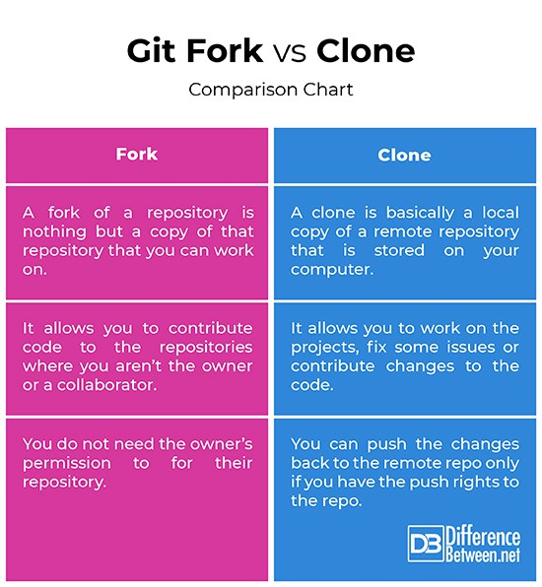
Fork vs Clone

Slide 53
Pull requests (PRs)
Submit your contributions
Accept or reject contributions of others
Merge changes to base code

Slide 54
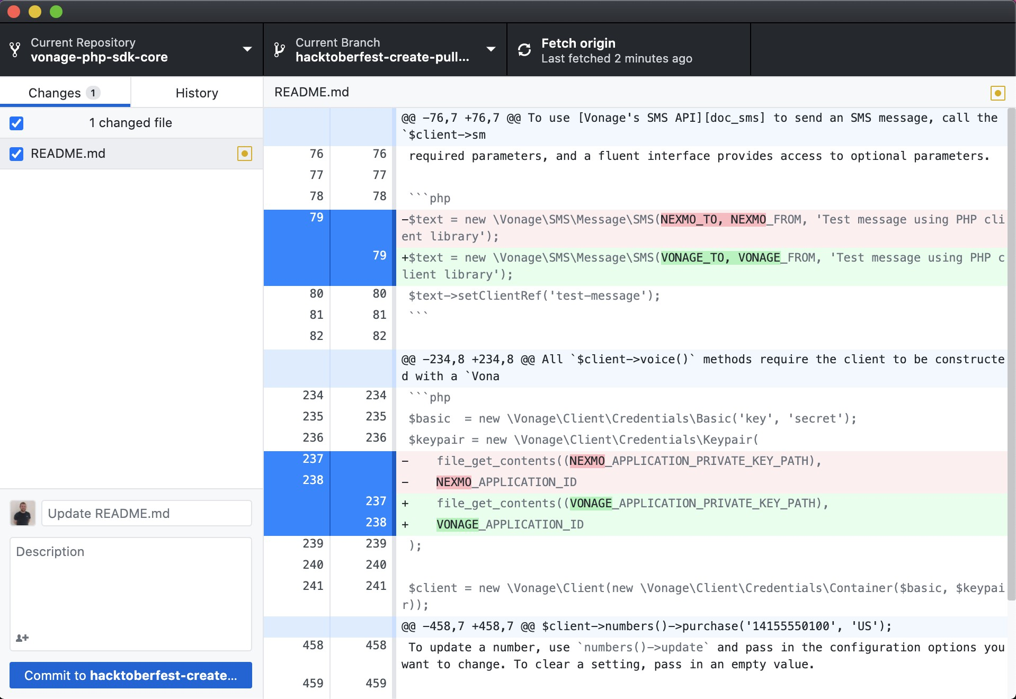
GitHub Desktop

